Slide 1

A LAB PROJECT ON
RAILWAY RESERVATION SYSTEM
BACHELOR OF TECHNOLOGY
IN
COMPUTER SCIENCE AND ENGINEERING
BY:
G.KARTHIK (23VE1A05E0)
K.KARTHIK (23VE1A05G0)
P.SRI CHANDANA (23VE1A05J2)
T.CHANDANA (23VE1A05J6)
T.KOWSHIK (23VE1A05J8)
ACADEMIC YEAR: 2024-2025

Slide 2
RAILWAY RESERVATION SYSTEM:
CONTENTS:
Abstract
ER Diagram
DDL Commands
DML Commands
Queries using Operators
Queries implementing Triggers

Slide 3
ABSTRACT
The Railway Reservation System is an online tool designed to make booking train tickets easier and faster. It helps solve problems like long lines at ticket counters and difficulty in finding train information. Users can register, check train availability, book tickets, and cancel them if needed, all through a simple interface.
The system uses a central database to keep track of train schedules and seat availability, allowing users to search for trains by their starting point, destination, and travel date. It also includes secure online payment options, making transactions safe and convenient.
For railway staff, the system provides features to manage train schedules, monitor bookings, and create reports. Overall, the Railway Reservation System improves how people book train tickets, making the experience quicker and more efficient for everyone.

Slide 4
Entities, Attributes, Relationships
Entities: (user,passenger,trains,food)
Attributes of passenger(pnr,name,mobile no,gender,age,seat)
Attributes of trains: (train no,train name,source,destination,arrival time,dept time)
Attributes of food: (fid,fname,price)
Relationships: 1 passenger can book many trains,1 passenger can order many food

Slide 5
Participation constraints and Cardinality Constraints:
1 passenger can book many trains(1-M)
1 passenger can order many food(1-M)

Slide 6
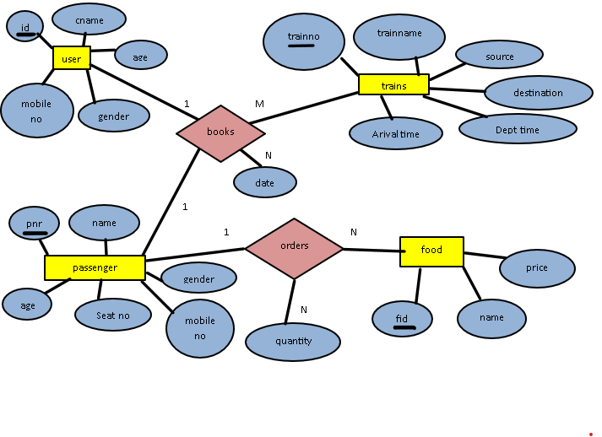

Slide 7
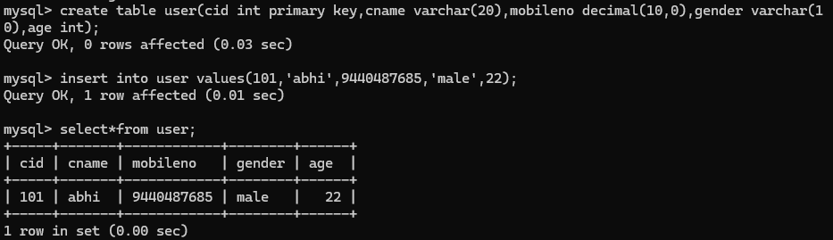
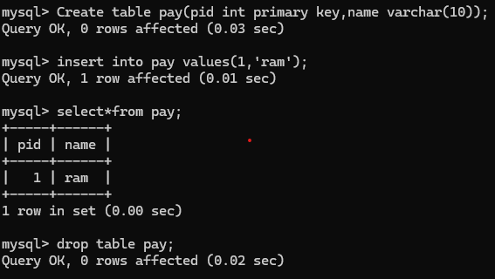
DDL COMMANDS
CREATE:
DROP:

Slide 8
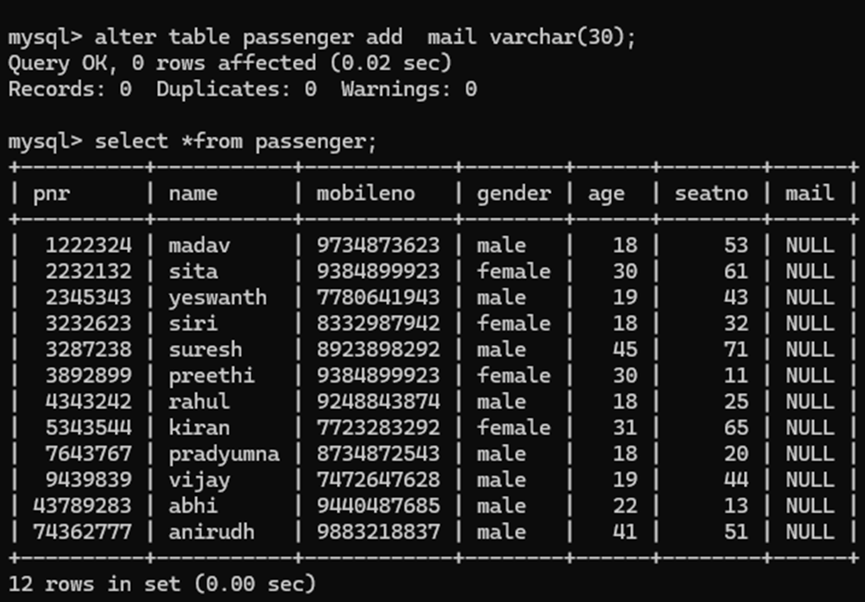
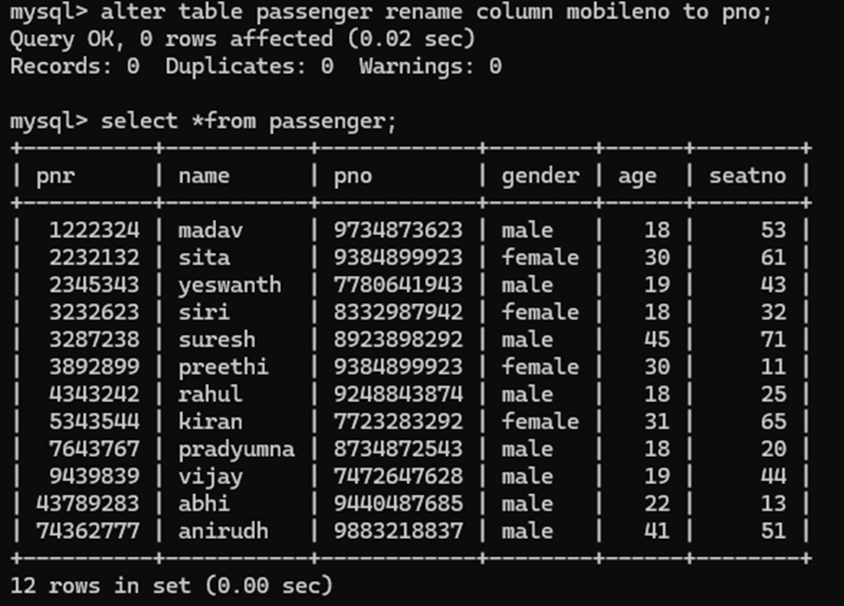
ALTER:
RENAME:

Slide 9
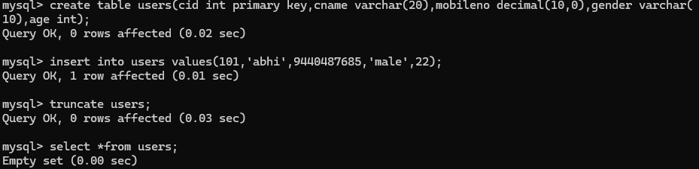
TRUNCATE:

Slide 10
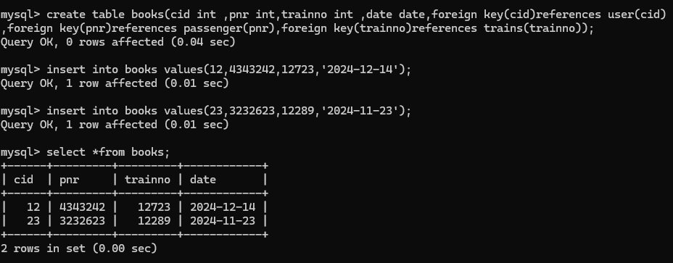
DML COMMANDS:
INSERT:

Slide 11
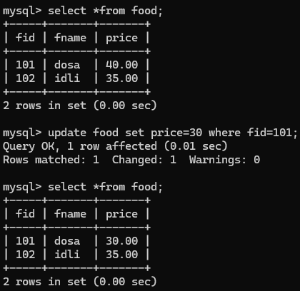
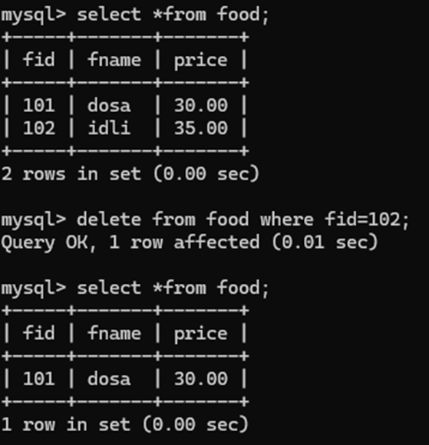
UPDATE: DELETE:

Slide 12
NORMALIZATION Normalization in database design is a technique used to minimize redundancy and dependency by organizing fields and tables within a relational database.
Normal Form |  | Condition |  | Goal
1 NF |  | Only atomic values |  | Eliminate repeating groups.
2 NF |  | 1NF + full dependency on primary key. |  | Eliminate partial dependencies.
3 NF |  | 2NF + no transitive dependencies. |  | Eliminate transitive dependencies.
BCNF |  | 3NF + every determinant is a superkey. |  | Stronger form of 3NF, focusing on superkeys.
4 NF |  | BCNF + no multi-valued dependencies. |  | Remove multi-valued dependencies.
5 NF |  | 4NF + no join dependencies (lossless join requirement). |  | Ensure accuracy of complex multiway relations.

Slide 13
User table
User(ID,Cname,mobileno,age,Gender) Analysis
There are no multi-valued dependencies, and no complex, multi-way relationships between attributes.Satisfies 5NF
Trains table
Trains(Train.no,Train.Name,Source,Destination,Arrival.time,Dept.time) Analysis
There are no multi-valued dependencies, and no complex, multi-way relationships between attributes.Satisfies 5NF
Passenger table:
Passenger(Pnr,Name,Gender,Age,Seat.no,Mobile.no) Analysis
There are no multi-valued dependencies, and no complex, multi-way relationships between attributes.Satisfies 5NF
Food table:
Food(Fid,Name,Price) Analysis
There are no multi-valued dependencies, and no complex, multi-way relationships between attributes.Satisfies 5NF
Books table
Books(ID,Train.no,Date) Analysis
There are no multi-valued dependencies, and no complex, multi-way relationships between attributes.Satisfies 5NF
Orders Table
Orders(Pnr,Fid,Date) Analysis
There are no multi-valued dependencies, and no complex, multi-way relationships between attributes.Satisfies 5NF

Slide 14
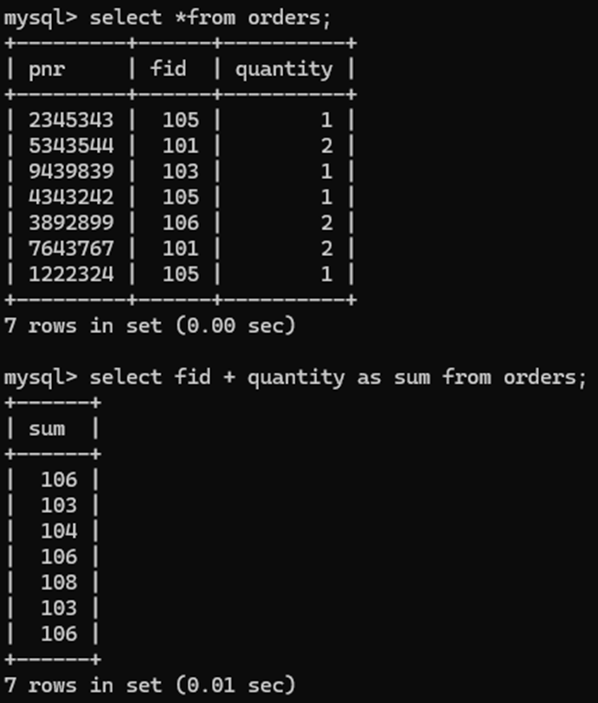
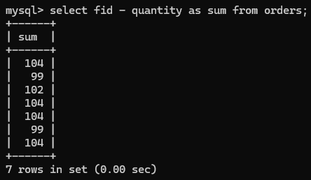
QUERIES USING ARITHEMETIC OPERATORS
ADD: SUBTRACT:

Slide 15
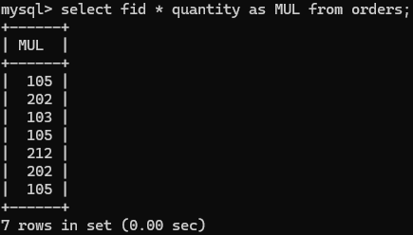
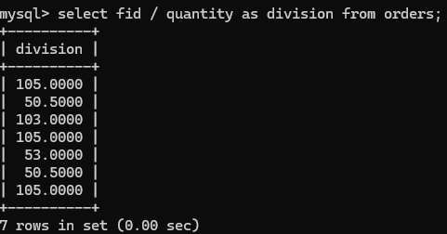
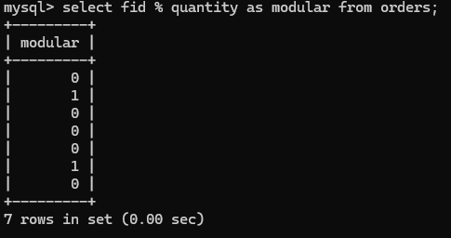
MULTIPLICATION: DIVISION:
MODULAR:

Slide 16
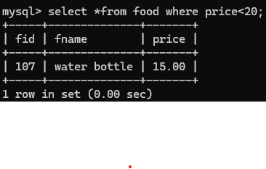
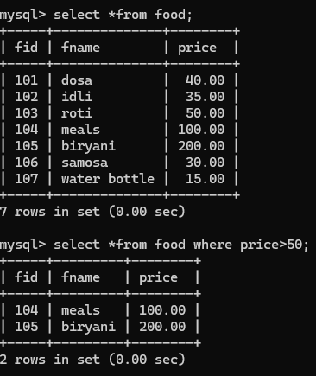
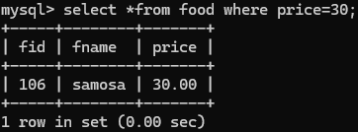
QUERIES USING RELATIONAL OPERATORS:
GREATER THAN(>): LESS THAN(<):
EQUAL TO(=):

Slide 17
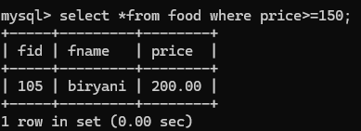
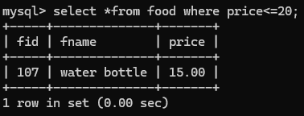
GREATER THAN OR EQUAL TO(>=):
LESS THAN OR EQUAL TO(<=):

Slide 18
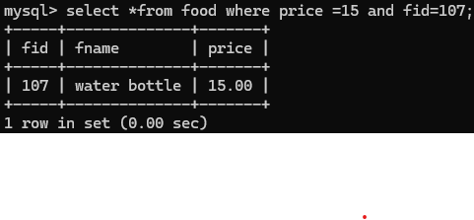
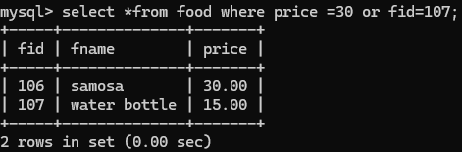
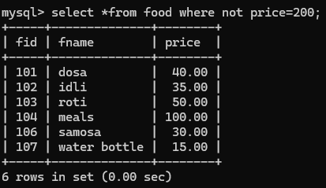
QUERIES USING OPERATORS
LOGICAL OPERATORS:
1.logical and:
2.logical or:
3.logical not

Slide 19
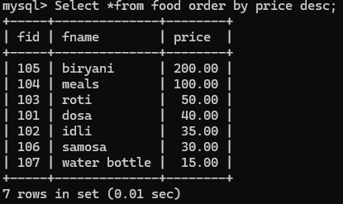
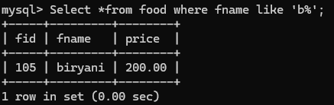
QUERIES USING OPERATORS
ORDER BY:
LIKE:

Slide 20
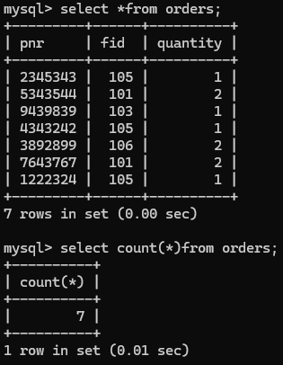
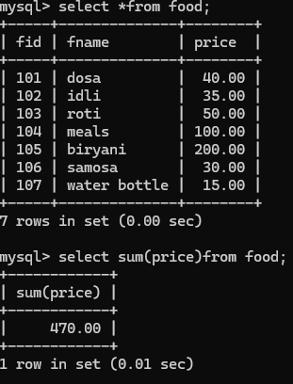
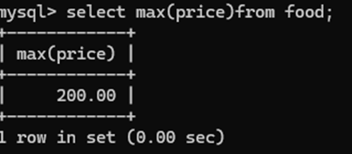
QUERIES USING AGGREGATE OPERATORS
COUNT(): sum():
MAX():

Slide 21
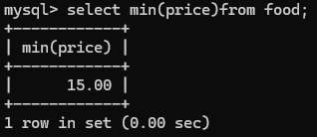
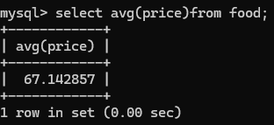
MIN():
AVG():

Slide 22
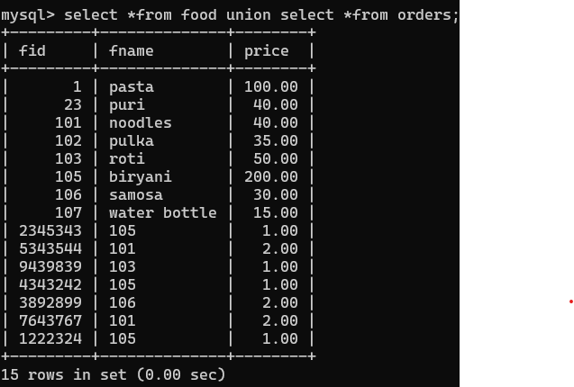
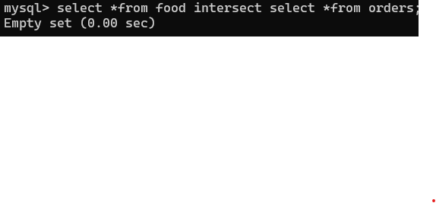
QUERIES USING SET OPERATORS
UNION:
INTERSECTION:

Slide 23
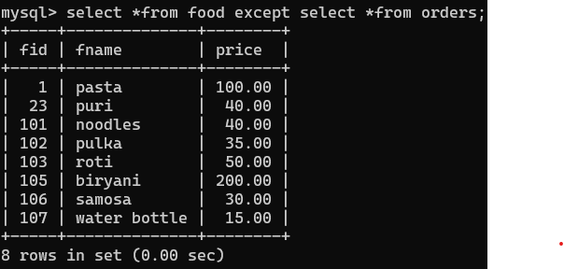
SET DIFFERENCE:

Slide 24
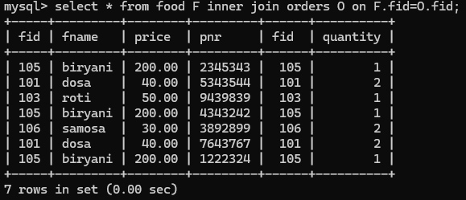
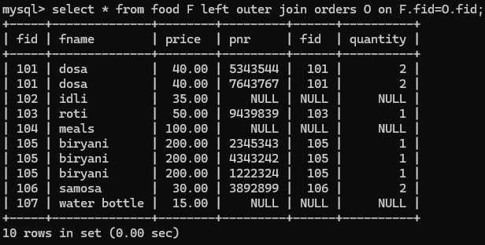
QUERIES USING JOIN OPERATORS
INNERJOIN:
LEFT OUTER JOIN:

Slide 25
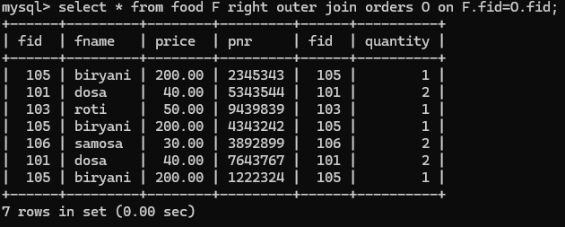
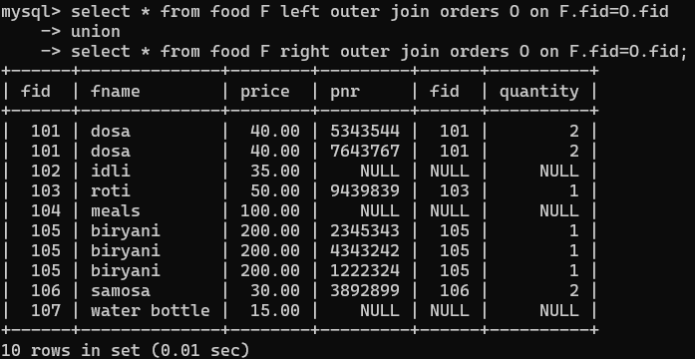
RIGHT OUTER JOIN:
FULL OUTER JOIN:

Slide 26
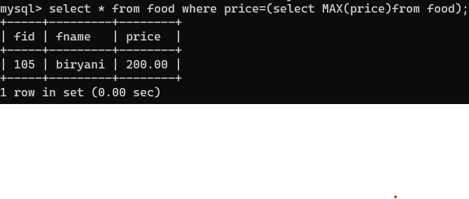
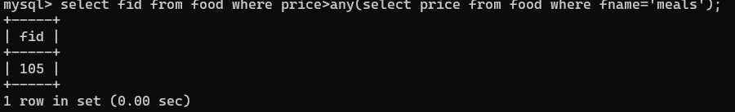
QUERIES USING Nested queries
QUERIES USING OPERATORS
ANY:

Slide 27
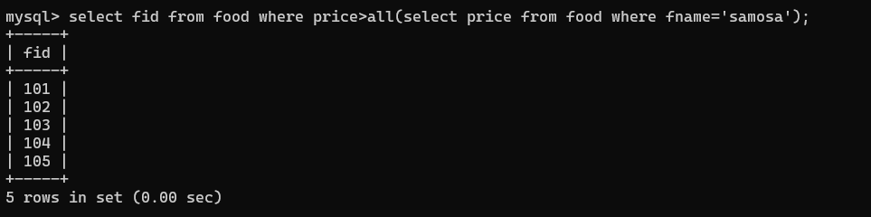
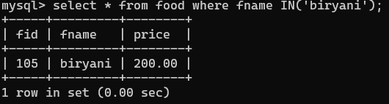
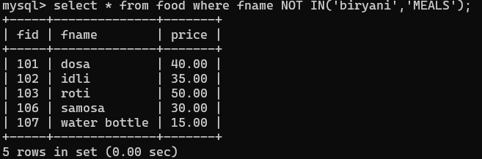
ALL:
IN:
NOT IN:

Slide 28
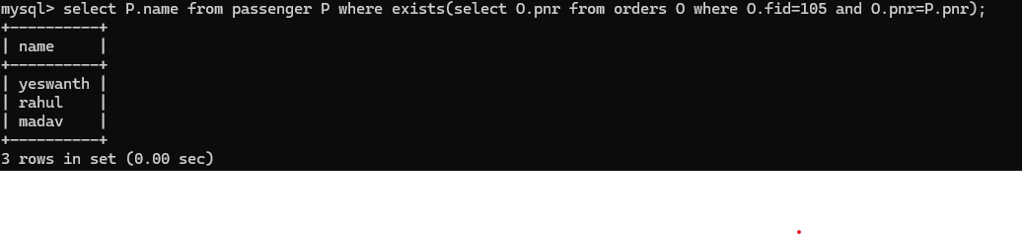
QUERIES USING OPERATORS
Correlated Subqueries :

Slide 29
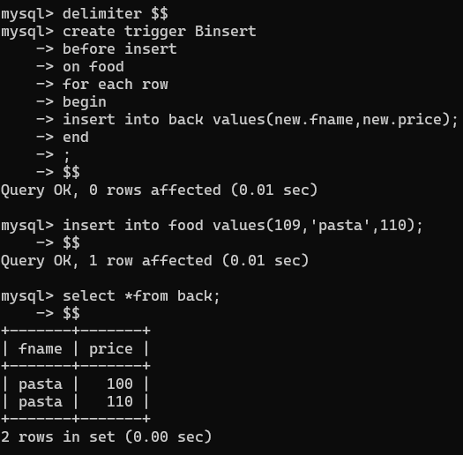
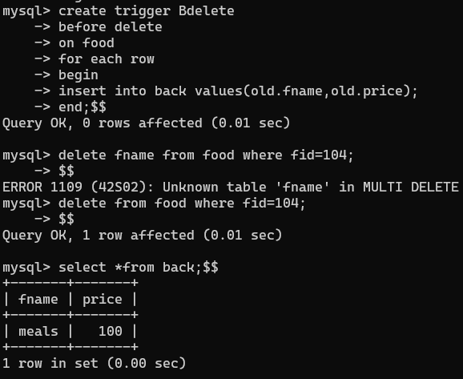
TRIGGERS
BEFORE INSERT TRIGGER: BEFORE DELETE TRIGGER:

Slide 30
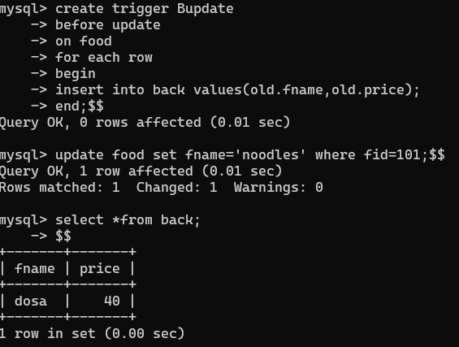
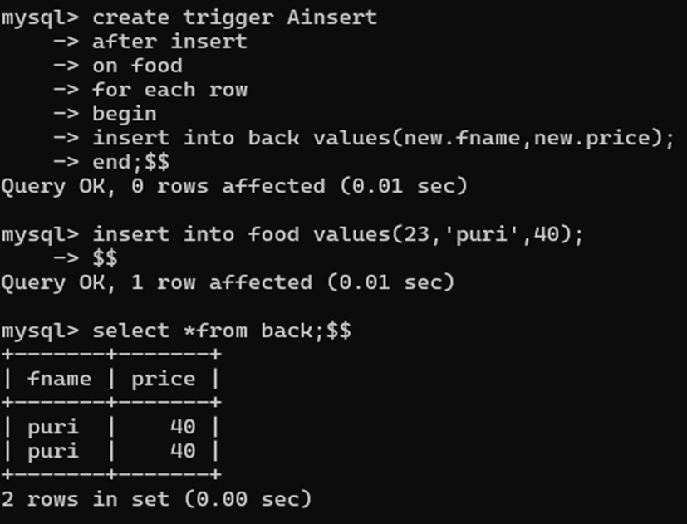
BEFORE UPDATE TRIGGER: AFTER INSERT TRIGGER:

Slide 31
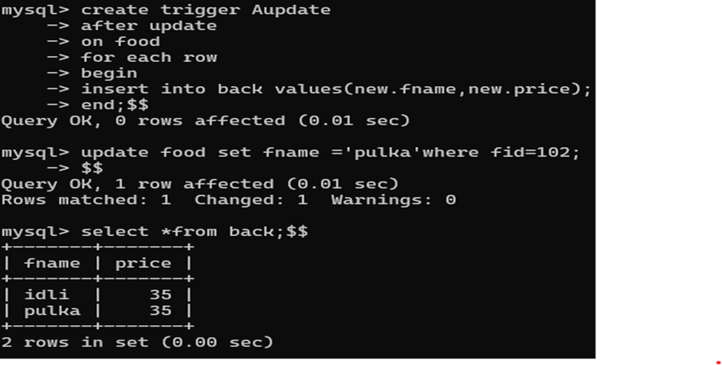
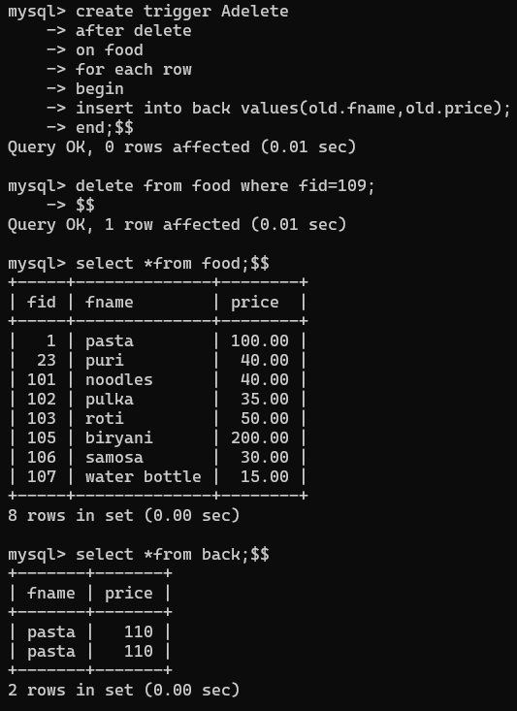
AFTER UPDATE TRIGGER: AFTER DELETE TRIGGER:

Slide 32
THANK YOU

